Slide 1
TIMER OPERATIONS

Slide 2
Features
A 32-bit Timer/Counter with a programmable 32-bit Prescaler.
Counter or Timer operation
Up to four 32-bit capture channels per timer, that can take a snapshot of the timer value when an input signal transitions. A capture event may also optionally generate an interrupt.
Four 32-bit match registers that allow:
– Continuous operation with optional interrupt generation on match.
– Stop timer on match with optional interrupt generation.
– Reset timer on match with optional interrupt generation.
Up to four external outputs corresponding to match registers, with the following capabilities:
– Set low on match.
– Set high on match.
– Toggle on match.
– Do nothing on match.

Slide 3
Applications

Slide 4
Timer Registers
A timer has a Timer Counter (TC) and Prescale Register(PR) associated with it.
When Timer is Reset and Enabled TC is set to 0 and incremented by 1 every ‘PR+1′ clock cycles.
When it reaches its maximum value it gets reset to 0 and hence restarts counting.
Prescale Register is used to define the resolution of the timer.
If PR=0 then TC is incremented every 1 clock cycle of the peripheral clock. If PR=1 then TC is incremented every 2 clock cycles of peripheral clock and so on.
By setting an appropriate value in PR we can make timer increment or count : every peripheral clock cycle or 1 microsecond or 1 millisecond or 1 second and so on.

Slide 5
Match Register (MR0, MR1, MR2, MR3)
A Match Register is a Register which contains a specific value set by the user. When the Timer starts – every time after TC is incremented the value in TC is compared with match register. If it matches then it can Reset the Timer or can generate an interrupt as defined by the user.
Match Registers can be used to:
Stop Timer on Match(i.e when the value in count register is same as that in Match register) and trigger an optional interrupt.
Reset Timer on Match and trigger an optional interrupt.
To count continuously and trigger an interrupt on match.

Slide 6
• MAT0.0 (2 pins) : P0.3 and P0.22
• MAT0.1 (1 pin) : P0.5
• MAT0.2 (2 pin) : P0.16 and P0.28
• MAT0.3 (1 pin) : P0.29
• MAT1.0 (1 pin) : P0.12
• MAT1.1 (1 pin) : P0.13
• MAT1.2 (2 pins) : P0.17 and P0.19
• MAT1.3 (2 pins) : P0.18 and P0.20
Notes:
Mcr and mer

Slide 7
Capture Register (CR0, CR1, CR2, CR3)
As the name suggests it is used to Capture Input signal. When a transition event occurs on a Capture pin , it can be used to copy the value of TC into any of the 4 Capture Register or to generate an Interrupt.
• CAP0.0 (3 pins) : P0.2, P0.22 and P0.30
• CAP0.1 (1 pin) : P0.4
• CAP0.2 (3 pin) : P0.6 (pin30), P0.16(pin46) and P0.28
• CAP0.3 (1 pin) : P0.29
• CAP1.0 (1 pin) : P0.10
• CAP1.1 (1 pin) : P0.11
• CAP1.2 (2 pins) : P0.17 and P0.19
• CAP1.3 (2 pins) : P0.18 and P0.21
Notes:
ccr

Slide 8
1) PR : Prescale Register (32 bit) – Stores the maximum value of Prescale counter after which it is reset.
2) PC : Prescale Counter Register (32 bit) – This register increments on every PCLK(Peripheral clock). This register controls the resolution of the timer. When PC reaches the value in PR , PC is reset back to 0 and Timer Counter is incremented by 1. Hence if PR=0 then Timer Counter Increments on every 1 PCLK. If PR=9 then Timer Counter Increments on every 10th cycle of PCLK. Hence by selecting an appropriate prescale value we can control the resolution of the timer.
3) TC : Timer Counter Register (32 bit) – This is the main counting register. Timer Counter increments when PC reaches its maximum value as specified by PR. If timer is not reset explicitly(directly) or by using an interrupt then it will act as a free running counter which resets back to zero when it reaches its maximum value which is 0xFFFFFFFF.
4) TCR : Timer Control Register (8 bit) – This register is used to enable , disable and reset TC. When bit0 is 1 timer is enabled and when 0 it is disabled. When bit1 is set to 1 TC and PC are set to zero together in sync on the next positive edge of PCLK. Rest of the bits of TCR are reserved.
5) CTCR : Count Control register (8 bit)– Used to select Timer/Counter Mode. When the value of the CTCR is set to 0×0 Timer Mode is selected.

Slide 9
6) MCR : Match Control register (16 bit) – This register is used to control which all operations can be done when the value in MR matches the value in TC. Bits 0,1,2 are for MR0 , Bits 3,4,5 for MR1 and so on.. Heres a quick table which shows the usage:
For MR0:
Bit 0 : Interrupt on MR0 i.e trigger an interrupt when MR0 matches TC. Interrupts are enabled when set to 1 and disabled when set to 0.
Bit 1 : Reset on MR0. When set to 1 , TC will be reset when it matched MR0. Disabled when set to 0.
Bit 2 : Stop on MR0. When set to 1 , TC & PC will stop when MR0 matches TC.
Similarly bits 3-5 , 6-8 , 9-11 are for MR1 , MR2 , MR3 respectively.
7) IR : Interrupt Register (8 bit) – It contains the interrupt flags for 4 match and 4 capture interrupts. Bit0 to bit3 are for MR0 to MR3 interrupts respectively. And similarly the next 4 for CR0-3 interrupts. when an interrupt is raised the corresponding bit in IR will be set to 1 and 0 otherwise. Writing a 1 to the corresponding bit location will reset the interrupt – which is used to acknowledge the completion of the corresponding ISR execution.

Slide 10
Setting up & configuring Timers
Set appropriate value in TxCTCR
Define the Prescale value in TxPR
Set Value(s) in Match Register(s) if required
Set appropriate value in TxMCR if using Match registers / Interrupts
Reset Timer – Which resets PR and TC
Set TxTCR to 0×01 to Enable the Timer when required
Reset TxTCR to 0×00 to Disable the Timer when required

Slide 11
Void initTimer0(void)
void initTimer0(void) { /*Assuming that PLL0 has been setup with CCLK = 60Mhz and PCLK also = 60Mhz.*/ T0CTCR = 0x0; T0PR = PRESCALE-1; //(Value in Decimal!) - Increment T0TC at every PRESCALE clock cycles T0TCR = 0x02; //Reset Timer }

Slide 12
Calculations
The delay or time required for 1 clock cycle at ‘X’ MHz is given by : (1 / X * (10^6)) Seconds
Hence in our case when PR=0 i.e TC increments at every PCLK the delay required for TC to increment by 1 is: ((0+1) / 60 * (10^6)) Seconds
Similarly when we set PR = 59999 the delay in this case will be: ((59999+1) / 60 * (10^6)) = (60000 / 60 * (10^6) = 1 / (10^3) Seconds
1/1000 = 0.001 Seconds which is nothing but 1 Milli-Second Hence the delay required for TC to increment by 1 will be 1mS.

Slide 13
delayMS(unsigned int milliseconds);
void delayMS(unsigned int milliseconds) //Using Timer0 { T0TCR = 0x02; //Reset Timer T0TCR = 0x01; //Enable timer while(T0TC < milliseconds); //wait until timer counter reaches the desired delay T0TCR = 0x00; //Disable timer }

Slide 14
#include <lpc214x.h> #define PRESCALE 60000 //60000 PCLK clock cycles to increment TC by 1 void delayMS(unsigned int milliseconds); void initTimer0(void); int main(void) { initTimer0(); //Initialize Timer0 IO0DIR = 0xFFFFFFFF; //Configure all pins on Port 0 as Output while(1) { IO0SET = 0xFFFFFFFF; //Turn on LEDs delayMS(500); //0.5 Second(s) Delay IO0CLR = 0xFFFFFFFF; //Turn them off delayMS(500); } }

Slide 15
void initTimer0(void) { /*Assuming that PLL0 has been setup with CCLK = 60Mhz and PCLK also = 60Mhz.*/ T0CTCR = 0x0; T0PR = PRESCALE-1; //(Value in Decimal!) - Increment T0TC at every 60000 clock cycles //Count begins from zero hence subtracting 1 //60000 clock cycles @60Mhz = 1 mS T0TCR = 0x02; //Reset Timer } void delayMS(unsigned int milliseconds) //Using Timer0 { T0TCR = 0x02; //Reset Timer T0TCR = 0x01; //Enable timer while(T0TC < milliseconds); //wait until timer counter reaches the desired delay T0TCR = 0x00; //Disable timer }

Slide 16
PWM
Pulse Width Modulation or PWM is a way to encode data such that it corresponds to the width of the pulse given a fixed frequency.
Its also a way to control motors , power circuits , etc.. using the ‘width’ of the pulse.
PWM has numerous uses like Motion Control , Dimming , Encoding Analog Signal into its Digital form , in Power Regulation , etc.
Pulse period and width can be any number of timer counts. This allows complete flexibility in the trade-off between resolution and repetition rate. All PWM outputs will occur at the same repetition rate.

Slide 17
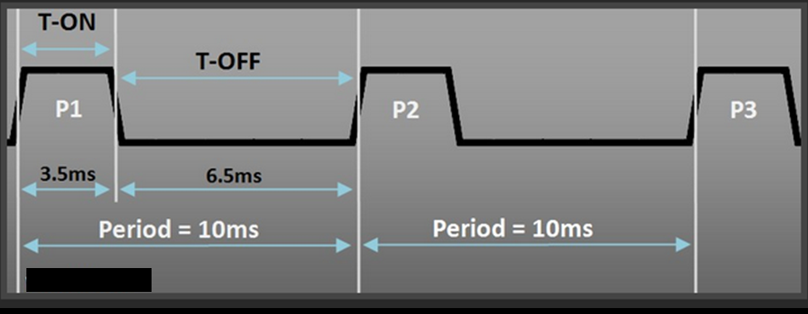

Slide 18
LPC2148 supports 2 types of PWM :
1) Single Edge PWM – PWM outputs all go high at the beginning of each cycle unless the output is a constant low.
2) Double Edge PWM – PWM outputs can have either edge occur at any position within a cycle. This allows for both positive going and negative going pulses.
Seven match registers allow up to 6 single edge controlled or 3 double edge controlled PWM outputs, or a mix of both types. The match registers also allow:
– Continuous operation with optional interrupt generation on match.
– Stop timer on match with optional interrupt generation.
– Reset timer on match with optional interrupt generation.

Slide 19
The PWM is based on the standard Timer block and inherits all of its features, although only the PWM function is pinned out on the LPC2141/2/4/6/8.
The Timer is designed to count cycles of the peripheral clock (PCLK) and optionally generate interrupts or perform other actions when specified timer values occur, based on seven match registers.
It also includes four capture inputs to save the timer value when an input signal transitions, and optionally generate an interrupt when those events occur.
The PWM function is in addition to these features, and is based on match register events.

Slide 20
Match registers for single edge controlled
Two match registers can be used to provide a single edge controlled PWM output. One match register (PWMMR0) controls the PWM cycle rate, by resetting the count upon match.
The other match register controls the PWM edge position.
Additional single edge controlled PWM outputs require only one match register each, since the repetition rate is the same for all PWM outputs. Multiple single edge controlled PWM outputs will all have a rising edge at the beginning of each PWM cycle, when an PWMMR0 match occurs.

Slide 21
Match registers for single edge controlled
Three match registers can be used to provide a PWM output with both edges controlled.
PWMMR0 match register controls the PWM cycle rate. The other match registers control the two PWM edge positions.
Additional double edge controlled PWM outputs require only two match registers each, since the repetition rate is the same for all PWM outputs.

Slide 22
Sample PWM waveform

Slide 23
Match Registers 1 to 6 (except 0) are pinned on LPC214x i.e. the corresponding outputs are diverted to actual Pins on LPC214x MCU. The PWM function must be selected for these Pins to get the PWM output. These pins are :
Also Match Register 0 i.e PWMMR0 is NOT pinned because it is used to generate the PWM Period.
Also the PWM function must be selected for the PINs mentioned above using appropriate PINSEL registers (PINSEL0 for PWM1,2,3,4,6 and PINSEL1 for PWM5).
Output : | PWM1 | PWM2 | PWM3 | PWM4 | PWM5 | PWM6
Pin Name : | P0.0 | P0.7 | P0.1 | P0.8 | P0.21 | P0.9

Slide 24
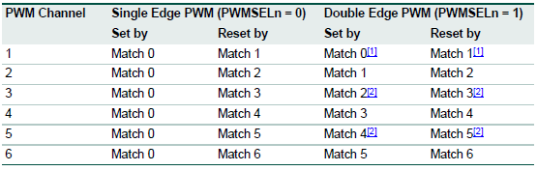

Slide 25
In LPC214x we have 7 match registers inside the PWM block .
Generally the first Match register PWMMR0 is used to generate PWM period and hence we are left with 6 Match Registers PWMMR1 to PWMMR6 to generate 6 Single Edge PWM signals or 3 Double Edge PWM signals.
Double edge PWM uses 2 match registers hence we can get only 3 double edge outputs.

Slide 26
Rules for single edge controlled PWM outputs
1. All single edge controlled PWM outputs go high at the beginning of a PWM cycle unless their match value is equal to 0.
2. Each PWM output will go low when its match value is reached. If no match occurs (i.e. the match value is greater than the PWM rate), the PWM output remains continuously high.

Slide 27
Rules for double edge controlled PWM outputs
1. The match values for the next PWM cycle are used at the end of a PWM cycle (a time point which is coincident with the beginning of the next PWM cycle), except as noted in rule 3.
2. A match value equal to 0 or the current PWM rate (the same as the Match channel 0 value) have the same effect, except as noted in rule 3. For example, a request for a falling edge at the beginning of the PWM cycle has the same effect as a request for a falling edge at the end of a PWM cycle.
3. When match values are changing, if one of the "old" match values is equal to the PWM rate, it is used again once if the neither of the new match values are equal to 0 or the PWM rate, and there was no old match value equal to 0.
4. If both a set and a clear of a PWM output are requested at the same time, clear takes
precedence. This can occur when the set and clear match values are the same as in, or when the set or clear value equals 0 and the other value equals the PWM rate.
5. If a match value is out of range (i.e. greater than the PWM rate value), no match event
occurs and that match channel has no effect on the output. This means that the PWM output will remain always in one state, allowing always low, always high, or "no change" outputs.

Slide 28
Working of PWM
Consider:
PWM Period duration= 6 milliseconds;
TC increments every 1 millisecond using appropriate pre-scale value.
Now set the match value in PWMMR0 as 6.
Then configure PWM block such that when TC reaches value in PWMMR0 it is reset and a new Period begins.
Example: we want 2 PWM signals of Pulse widths 2ms and 4ms.
So, use PWMMR1 and PWMMR2 to get the 2 outputs.
Set PWMMR1 = 2 and PWMMR2 = 4.
Then , Everytime a new period starts the Pin corresponding to PWMMR1 (p0.0) and PWMMR2 (p0.7) will be set High by default.
And whenever the value in TC reaches PWMMR1 and PWMMR2 its output will be set to low respectively.
Their outputs will remain low until the next Period starts after which their outputs again become high. Hence giving us Single Edge PWM.

Slide 29
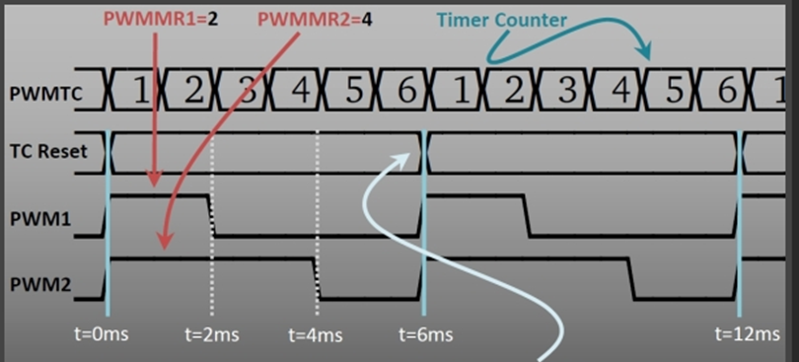

Slide 30
Registers in PWM
1) PWMTCR (8 bit) : PWM Timer Control Register
This register is used to control the Timer Counter inside the PWM block. Only Bits: 0, 1 & 3 are used rest are reserved.
Bit 0 : This bit is used to Enable/Disable Counting. When 1 both PWM Timer counter and PWM Prescale counter are enabled. When 0 both are disabled.
Bit 1 : This bit is used to Reset both Timer and Prescale counter inside the PWM block. When set to 1 it will reset both of them (at next edge of PCLK).
Bit 3 : This is used to enable the PWM mode i.e the PWM outputs.
Other Bits : Reserved.
2) PWMPR (32 bit) : PWM Prescale Register
PWMPR is used to control the resolution of the PWM outputs. The Timer Counter(TC) will increment every PWMPR+1 Peripheral Clock Cycles (PCLK).
3) PWMMR0 – PWMMR6 : Match Registers
These are the seven Match registers as explained above which contain Pulse Width Values i.e the Number of PWMTC Ticks.

Slide 31
4) PWMMCR (32 bit) : PWM Match Control Registers
The PWM Match Control Register is used to specify what operations can be done when the value in a particular Match register equals the value in TC. For each Match Register we have 3 options : Either generate an Interrupt , or Reset the TC , or Stop .. which stops the counters and disables PWM. Hence this register is divided into group of 3 bits. The first 3 bits are for Match Register 0 i.e PWMMR0 , next 3 for PWMMR1 , and so on :
1) Bit 0 : Interrupt on PWMMR0 Match – If set to 1 then it will generate an Interrupt else disable if set to 0.
2) Bit 1 : Reset on PWMMR0 Match – If set to 1 it will reset the Timer Counter i.e PWMTC else disabled if set to 0.
3) Bit 2 : Stop on PWMMR0 Match – If this bit is set 1 then both PWMTC and PWMPC will be stopped and will also make Bit 0 in PWMTCR to 0 which in turn will disable the Counters.
*) Similarly {Bits 3,4,5} for PWMMR1 , {Bits 6,7,8} for PWMMR2 , {Bits 9,10,11} for PWMMR3 ,{Bits 12,13,14} for PWMMR4 ,{Bits 15,16,17} for PWMMR5 , {Bits 18,19,20} for PWMMR6.

Slide 32
5) PWMIR (16 bit) : PWM Interrupt Register
If an interrupt is generated by any of the Match Register then the corresponding bit in PWMIR will be set high. Writing a 1 to the corresponding location will clear that interrupt. Here :
1) Bits 0,1,2,3 are for PWMMR0, PWMMR1, PWMMR2, PWMMR3 respectively and
2) Bits 8,9,10 are for PWMMR4 , PWMMR5 , PWMMR6 respectively. Other bits are reserved.

Slide 33
6) PWMLER (8 bit): Latch Enable Register
The PWM Latch Enable Register is used to control the way Match Registers are updated when PWM generation is active. When PWM mode is active and we apply new values to the Match Registers the new values won’t get applied immediately. Instead what happens is that the value is written to a “Shadow Register” .. it can be thought of as a duplicate Match Register. Each Match Register has a corresponding Shadow Register. The value in this Shadow Register is transferred to the actual Match Register when :
1) PWMTC is reset (i.e at the beginning of the next period) , 2) And the corresponding Bit in PWMLER is 1.
Hence only when these 2 conditions are satisfied the value is copied to Match Register. Bit ‘x’ in PWMLER corresponds to match Register ‘x’. I.e Bit 0 is for PWMMR0 , Bit 1 for PWMMR1 , .. and so on..

Slide 34
7) PWMPCR (16 bit) : PWM Control Register
This register is used for Selecting between Single Edged & Double Edged outputs and also to Enable/Disable the 6 PWM outputs which go to their corresponding Pins.
( 1) Bits 2 to 6 are used to select between Single or Double Edge mode for PWM 2,3,4,5,6 outputs.
1) Bit 2 : If set to 1 then PWM2(i.e the one corresponding to PWMMR2) output is double edged else if set 0 then its Single Edged.
2) Similarly {Bits 3,4,5,6} for PWM3 , PWM4 , PWM5 , PWM6 respectively.
2) Bits 9 to 14 are used to Enable/Disable PWM outputs
1) Bit 9 : If set to 1 then PWM1 output is enabled , else disabled if set to 0. 2)Similarly {Bit 10,11,12,13,14} for PWM2 , PWM3 , PWM4 , PWM5 , PWM6 respectively.
)

Slide 35
Rules for single edge controlled PWM outputs
1. All single edge controlled PWM outputs go high at the beginning of a PWM cycle unless their match value is equal to 0.
2. Each PWM output will go low when its match value is reached. If no match occurs (i.e. the match value is greater than the PWM rate), the PWM output remains continuously high.

Slide 36
Configuring and Initializing PWM
Configuring PWM is very much similar to Configuring Timer except , additionally , we need to enable the outputs and select PWM functions for the corresponding PIN on which output will be available.
First we need to define the resolution of PWM signal.
Here the PWM resolution means the minimum increment that can be used to increase or decrease the pulse width.
More smaller the increment more fine will be the resolution. This resolution is defined using an appropriate Pre scale Value.

Slide 37
Steps for initializing PWM
Select the PWM function for the PIN on which you need the PWM output using PINSEL0/1 register.
Select Single Edge or Double Edge Mode using PWMPCR. By default its Single Edge Mode.
Assign the Calculated value to PR.
Set the Value for PWM Period in PWMMR0.
Set the Values for other Match Registers i.e the Pulse Widths.
Set appropriate bit values in PWMMCR .. like for e.g. resetting PWMTC for PWMMR0 match and optionally generate interrupts if required
Set Latch Enable Bits for the Match Registers that you’ve used. This is important!
Then Enable PWM outputs using PWMPCR.
Now Reset PWM Timer using PWMTCR.
Finally .. Enable Timer Counter and PWM Mode using PWMTCR.

Slide 38
LED Dimming example with PWM
#include <lpc214x.h>
void initPWM(void);
int main(void) { initPWM(); //Initialize PWM while(1) { if( !((IO0PIN) & (1<<1)) ) // Check P0.1 { PWMMR1 = 2500; //T-ON=25% , Hence 25% Bright PWMLER = (1<<1); //Update Latch Enable bit for PWMMR1 } else if( !((IO0PIN) & (1<<2)) ) // Check P0.2 { PWMMR1 = 5000; //50% Bright PWMLER = (1<<1); }

Slide 39
else if( !((IO0PIN) & (1<<3)) ) // Check P0.3 { PWMMR1 = 7500; //75% Bright PWMLER = (1<<1); } else if( !((IO0PIN) & (1<<4)) ) // Check P0.4 { PWMMR1 = 10000; //100% Bright PWMLER = (1<<1); } } //return 0; //normally this wont execute ever }

Slide 40
void initPWM(void) { /*Assuming that PLL0 has been setup with CCLK = 60Mhz and PCLK also = 60Mhz.*/ PINSEL0 = (1<<1); // Select PWM1 output for Pin0.0 PWMPCR = 0x0; //Select Single Edge PWM - by default its single Edged so this line can be removed PWMPR = PWMPRESCALE-1; // 1 micro-second resolution PWMMR0 = 10000; // 10ms period duration PWMMR1 = 2500; // 2.5ms - pulse duration i.e width (Brigtness level) PWMMCR = (1<<1); // Reset PWMTC on PWMMR0 match PWMLER = (1<<1) | (1<<0); // update MR0 and MR1 PWMPCR = (1<<9); // enable PWM output PWMTCR = (1<<1) ; //Reset PWM TC & PR //Now , the final moment - enable everything PWMTCR = (1<<0) | (1<<3); // enable counters and PWM Mode //PWM Generation goes active now - LED must be 25% Bright after Reset!! //Now you can get the PWM output at Pin P0.0! }

